Slide 1


DevOperability
Alex Moore
Senior System Build Engineer
TransUnion UK
Twitter @smileandeliver
GitHub https://github.com/smileandeliver/
Notes:
DevOps Engineer / Deployment Monkey / Ex IT, Ops, Support, Marketing … dot net with a bit of linux. I am lucky to work with some of the more linuxy teams
Started working on this because it’s something that I always have a bee in my bonnet about. Also CoPs wanted to write operability TESTING standards/guidelines. Realised talking to test colleagues embedded in the dev teams, how far away we were from even understanding operability never mind making sure we were testing for it Early. I pulled out a sheet of NFRs and actually got “we don’t need to worry about that in our world.” from one person. So I started to research, talk to dev and ops people in our own organisation and outside… to pull together some info to feed into our Operability standards
I realised that some of our own antipatterns and issues are actually very common so even though some of it is a bit devops 101, it needs calling out.
Challenge… who can get all the way through this talk knowing that they’ve not got any of the issues I've described and are thinking of all the elements of Operability back at walking skeleton stage

Slide 2
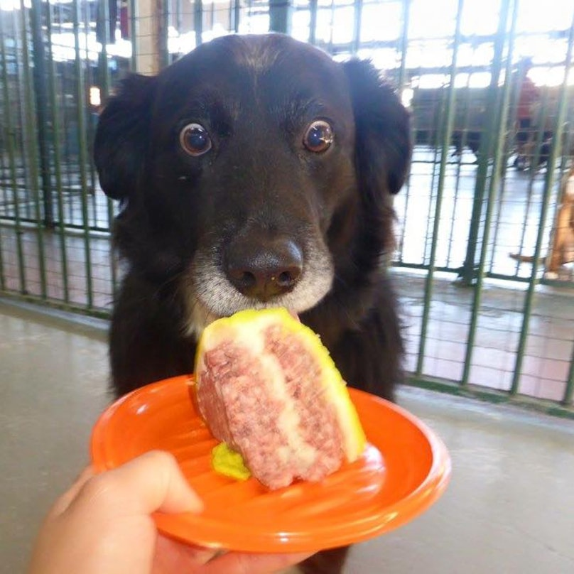
DevOps
@smileandeliver
Notes:
I’ll talk a bit about how we’ve tried to implement DevOps, we have had a lot of success… but I am going to highlight some detail; some of the key mistakes that we’ve made, bringing together stories and comments from my colleagues internally as well as some comments from Dev and Ops people in other organisations. We are a large company that’s just been taken over by an even larger one so our challenges are scaled up with us.
The fact is we have excellent Uptime and meet our SLAs… but we must still do better we still have the odd sleepless night or incident. We still have whole teams gathering to do a deployment We can’t let it lie.

Slide 3




Dev
Ops
@smileandeliver
Notes:
Started off with the classic problem… Dev wanted change, Ops wanted stability. Locked in a battle where not only their team practices were at odds but their goals, the way they were told to behave by their management was also in conflict.

Slide 4
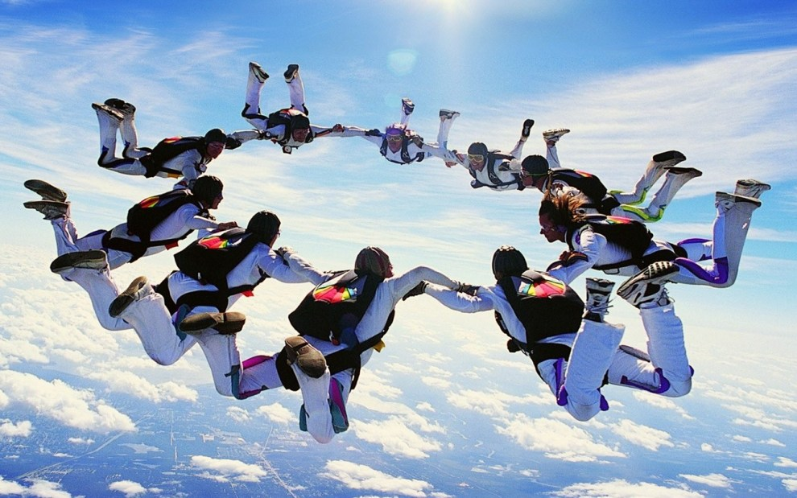
@smileandeliver
Notes:
We knew where we wanted to be…

Slide 5

Dev
Ops
Build Teams
@smileandeliver

Slide 6

Dev
Ops
Build Teams
@smileandeliver
Notes:
Originally I drew all these walls the same size but the more I talked to Ops, within our own organisation and outside… I realised that the wall between Ops and the rest of the org is very significant

Slide 7
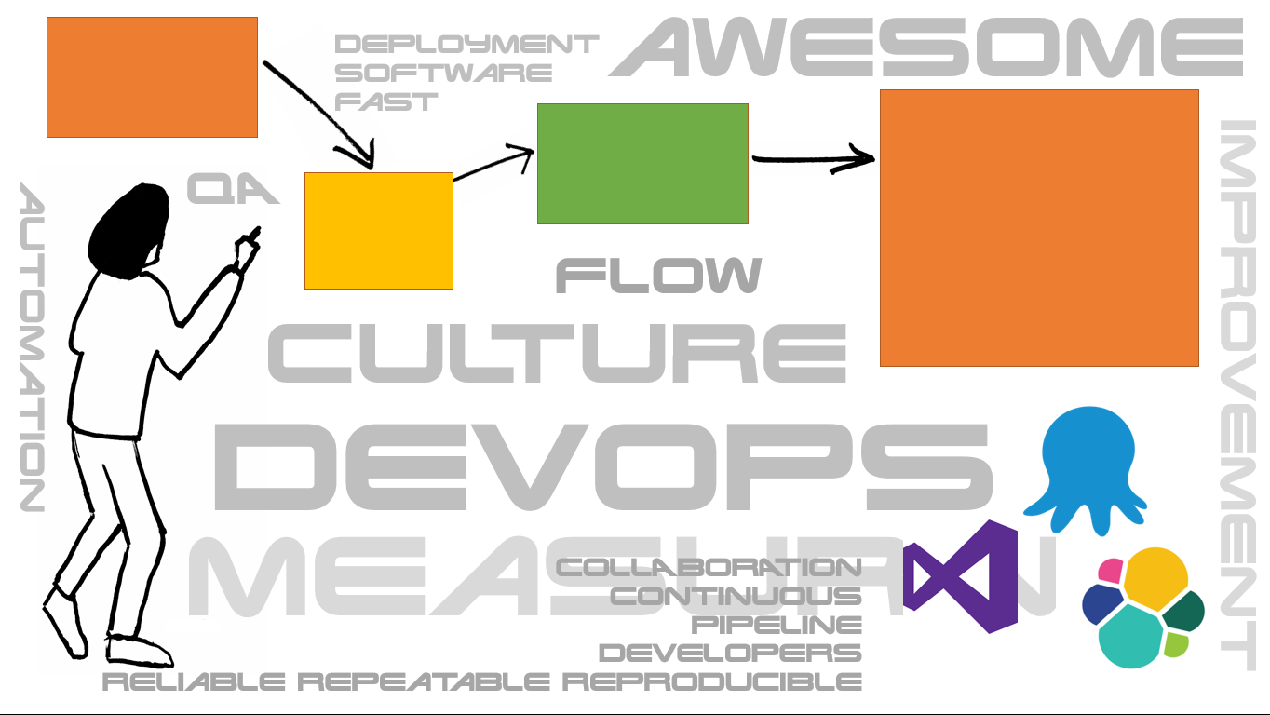
C
A
L
M
S
CULTURE
@smileandeliver
Notes:
Take this back down to the CALMS model and it’s easy to see where we are failing our ops teams.
Enabling people to do awesome stuff! Allowing innovation rather than inflicting things on the engineers
Providing a framework ; a common language – security standards and onboarding mechanism. Over which collaboration and innovation can occur
We’re great at doing this within Dev + deployment but not Ops – Ops are more and more in Kaunas so massive physical barrier though not in general a cultural one – challenge to involve them more at the inception of any dev work
“ The organizational culture leads to what gets delivered.” – Gene Kim
We rarely meet with Ops, involve them in planning or socialise with them

Slide 8


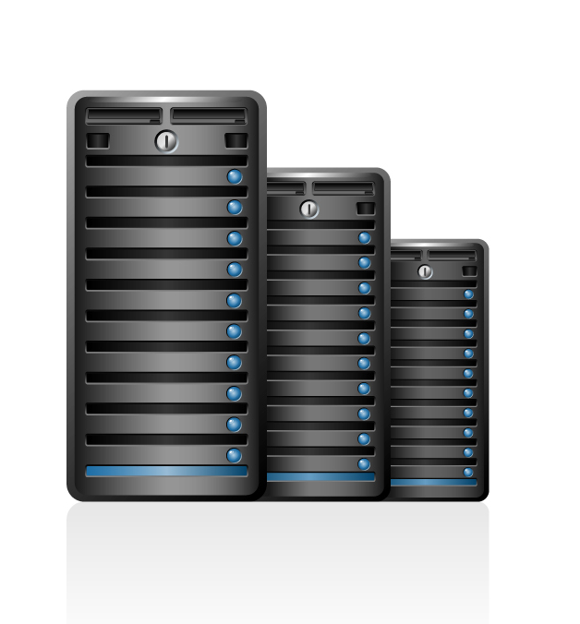



C
A
L
M
S
AUTOMATION
@smileandeliver
Notes:
Automation is probably the thing we’re best at. We have the tools, we are comfortable with our tooling; we may even have written standards and guides around them! We optimise flow from idea to value
So then you get a Pink fluffy unicorn to just magically take you components into production!! automate the repetitive and the boring stuff so human beings can concentrate on AWESOME stuff
So we’re in a place where people from the Dev side are, with the right gatekeeping, checks, balances, security etc pushing to production
But what’s happening once we are IN production

Slide 9
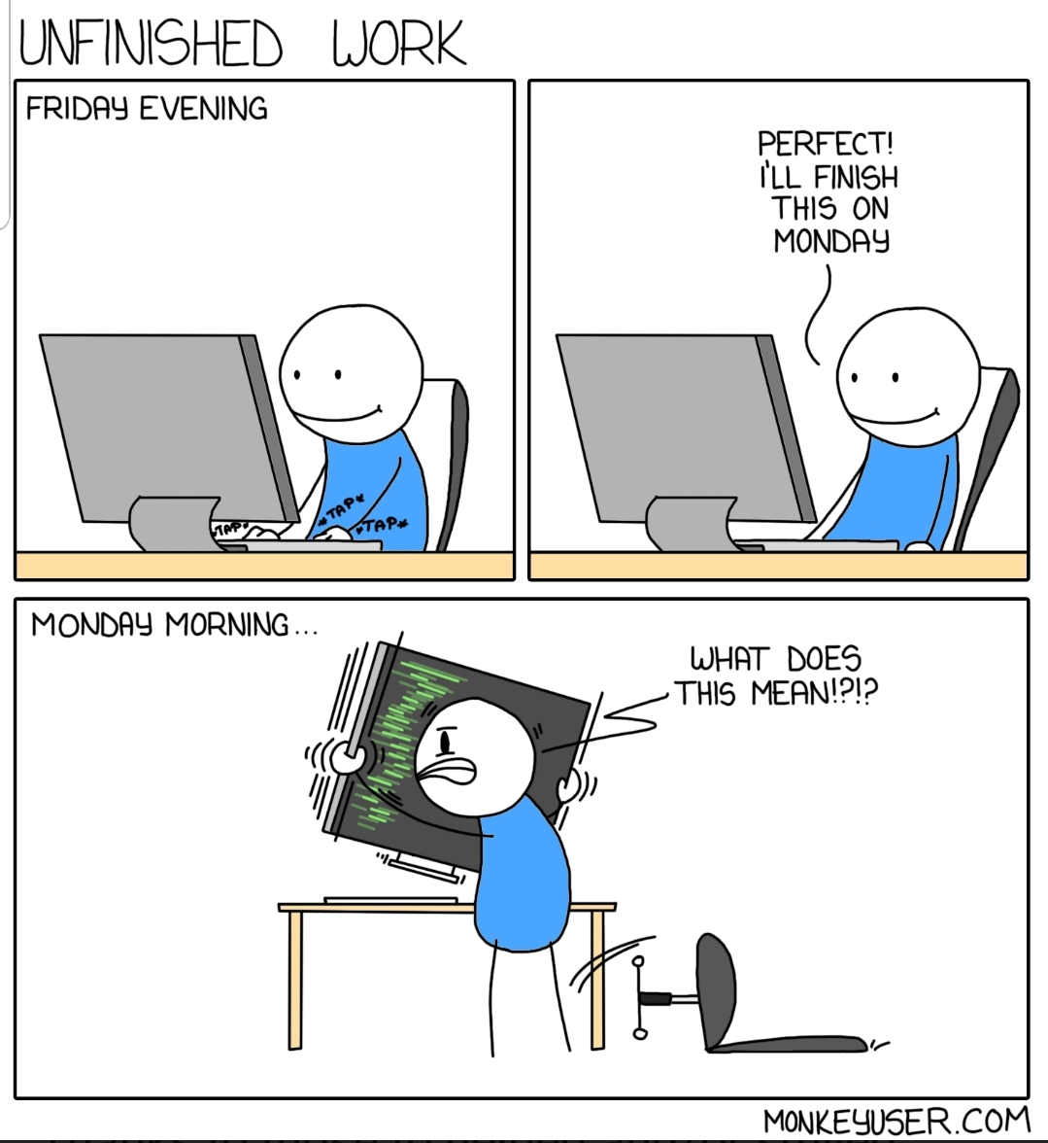
C
A
L
M
S
LEAN
Notes:
Create the awesomeness in small batches and get them submitted and tested fast!
Map out and understand the whole value stream from the awesome idea to where the awesomeness can be enjoyed by the end users
But yes once it’s available we don’t hear any more about it until there’s a issue

Slide 10

C
A
L
M
S
MEASUREMENT
@smileandeliver
Notes:
How awesome is it? Awesome!!
This is the one space where Dev and Ops have more opportunity to see what’s going on as we have ELK stack – ELKB – Elastic…

Slide 11
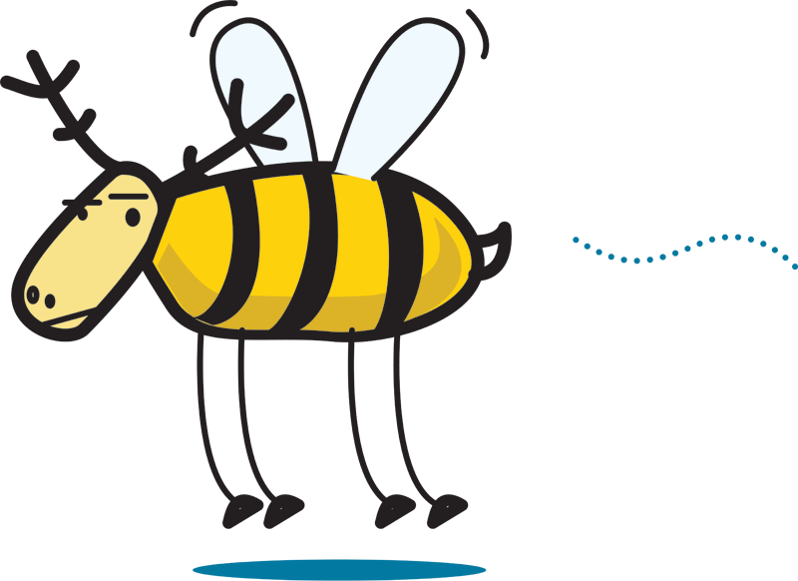
C
A
L
M
S
MEASUREMENT
@smileandeliver
Notes:
How awesome is it? Awesome!!
This is the one space where Dev and Ops have more opportunity to see what’s going on as we have ELK stack – ELKB – Elastic…

Slide 12
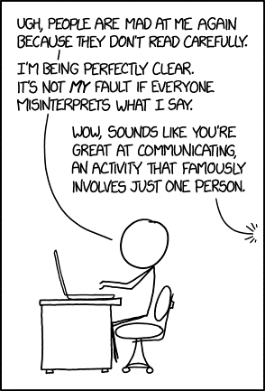
C
A
L
M
S
SHARING
Notes:
Communicate, learn, shout about it, be honest. It’s Awesome.
New Walls

Slide 13
DevDev
@smileandeliver
Notes:
So what we are doing is not really DevOps
All across the DevOps movement, We are doing DevDev Very Well – we’re even killing it at DevPlatform.
We are automating the creation of our environments and platforms, we’re even testing them. Our software deployment is getting better and better… it’s all automated. But what happens after Live
But until we crack Operability, We do NOT have DevOps!
why does it matter – what are we going to do about it…

Slide 14

We can have fantastic sales,
account management, innovative products,
good pricing,
fabulous marketing…
But if we don’t deliver the service
they will not come to us
and/or walk away
@smileandeliver
Notes:
Something one of our chief officers said and I’ve nicked it!
Fact is… we do have genuinely excellent customer satisfaction but we must deliver that service well within sla, maintain the expected uptime forever. So on we go
We don’t promise 100% availability of course but every month our core products show 100% uptime we rejoice
Here goes with where we know we’re going wrong

Slide 15

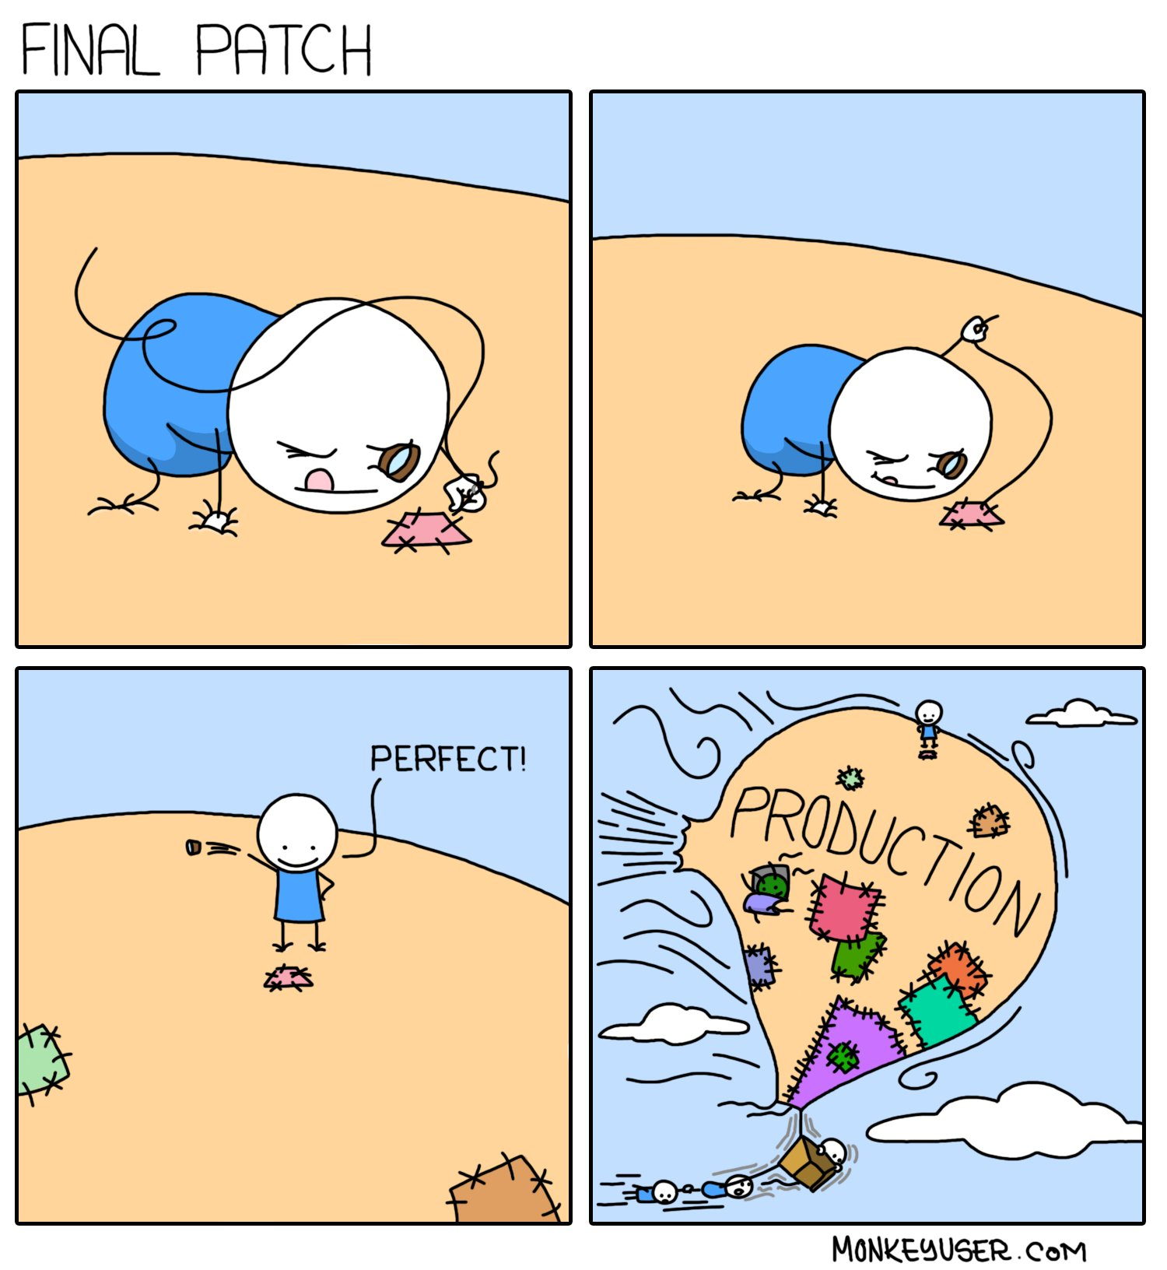
@smileandeliver
Notes:
Brass tacks – Operability. First let’s look at Where we are going wrong. We can put out something that passes all its software and functional testing but which is a nightmare waiting to happen.
DevOps 101 alert… this is not about taking responsibility for EVERYTHING that happens in the entire organisation, it’s about everyone working seamlessly with shared knowledge and understanding – thinking beyond the software, the pipeline…
Maybe you will become an Operability guru. Maybe you’ll have a different niche – but mainly if you have the right awareness of Operability, you then have the power to make sure that *someone* is doing it!
Wot we did wrong… Amazing product, highest availability, innovative architecture. Forgot about patching. Cannot be patched without downtime.

Slide 16
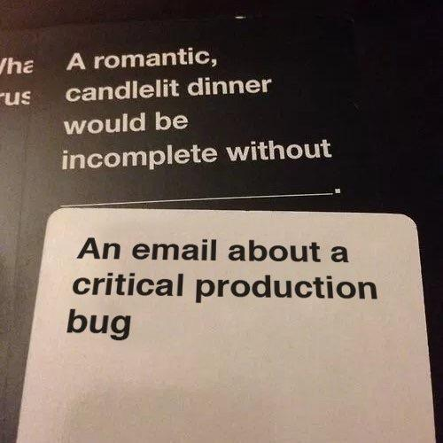
"Development" teams get something "working" then throw it to an "Operations" team who struggle to wrestle with the day-to-day running and support of it.
Software Scoped to Functional Reqs
No Resources once in Production
Deliverable ≠ Operable
@smileandeliver
Notes:
requirements of the system/software so narrowly scoped to get it doing what it needs to do so we can say it's done. Non-functional, operational requirements (e.g. monitoring/support/upgrades/decommissioning/data retention/cleanup etc.) get overlooked and/or aren't considered.
Wot we did wrong
"Application Lifecycle Management" – need to complete the loop
All the time/effort/money/resources gets put in at the start of a "project", then when something is delivered, all the resources get taken away
The killer assumption(s) that once something is built/released and in Production, that it's "done"/"working"/"delivering" and doesn't cost any time/effort/money/resources to support and will never have any *serious* problems. More products are released for the same ops resource.

Slide 17
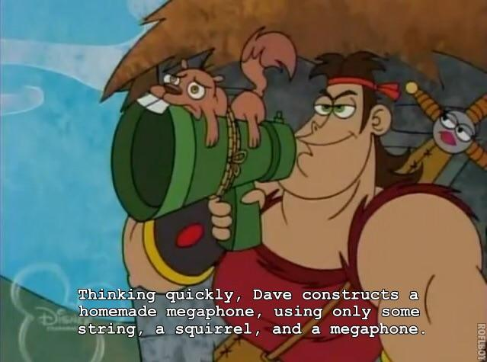
Complexity:
One of the greatest enemies of Operability
@smileandeliver
Notes:
Wot we did wrong
Have we delivered the Requirements in the most efficient way? Is there a complicated and error prone process in order to switch between live environments? Does a change in config require disruptive restarts? Do you have to do stuff manually?
Architecture
Innovation vs Known Tech
AIS? We actually do use some systems and techs that were never properly AIS ed
Ops:“Even when the rest of the organisation does let us know about the new stuff they are going to use, all it takes are a few incidents and we don’t have time to learn and test it before it goes into production”

Slide 18
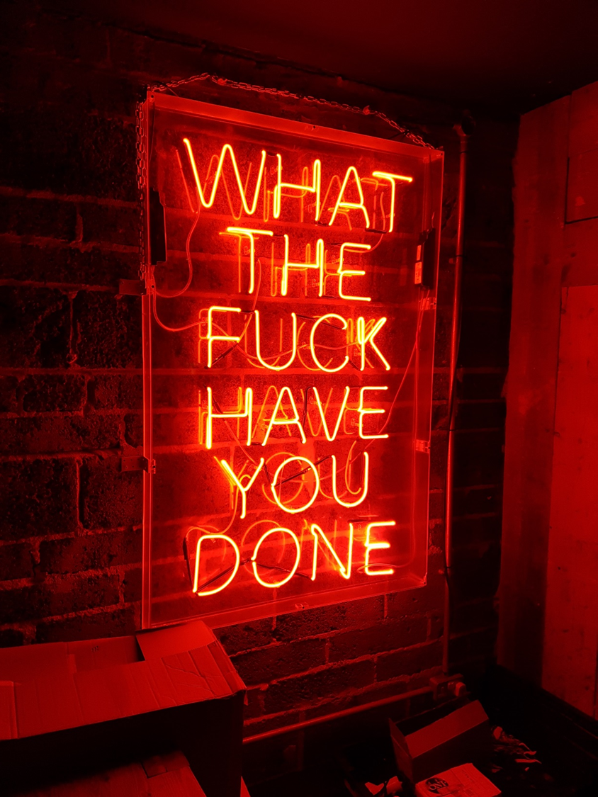
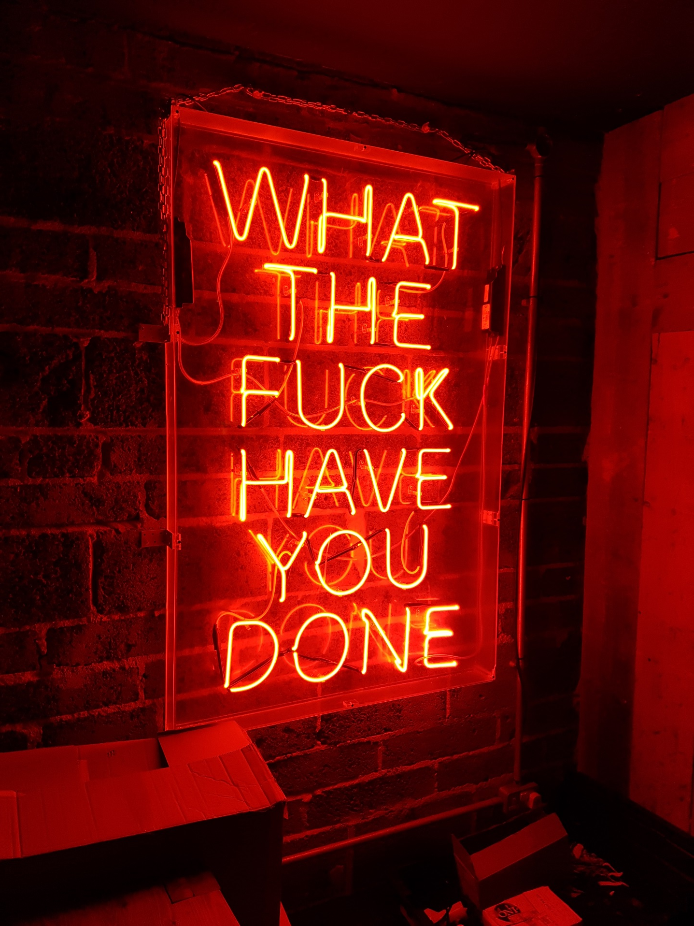

Do you know what just happened and why?
The Right Metrics
Dependencies
Sterile Environments
Access Auditing
Diagnostics
@smileandeliver
Notes:
Wot we did wrong
Metrics – are they telling you what the F is going on ? Can you see if it’s a dependency that’s failed rather than the core system? (we thought we could and then one day we couldn’t!)
Are the environments so sterile that your tests in preprod are gonna be truly representative of Prod so that you can troubleshoot without touching Live? Nope. Some are… getting better.
Do you have the information that says exactly what just happened? - actually our auditing as you’d expect, is excellent. But getting at that info is not always so easy.
“ get the sh** in there for now and worry about parsing it later”

Slide 19

Hero
Or
Victim?
“Well done everyone on the mammoth effort it took to….”
@smileandeliver
Notes:
Whats wrong

Slide 20


Operability
Your Ops Teams are now the Customer
Deployment Engineers
Ops Engineers
Customer Support
Configuration Team
@smileandeliver
Notes:
SO WHAT DOES GOOD OPERABILITY LOOK LIKE
Change in perspective.
Ops teams are now your customer – not the end users
Operability is about making software that is reliable and handles failure gracefully in production
So how SHOULD we be doing this?

Slide 21
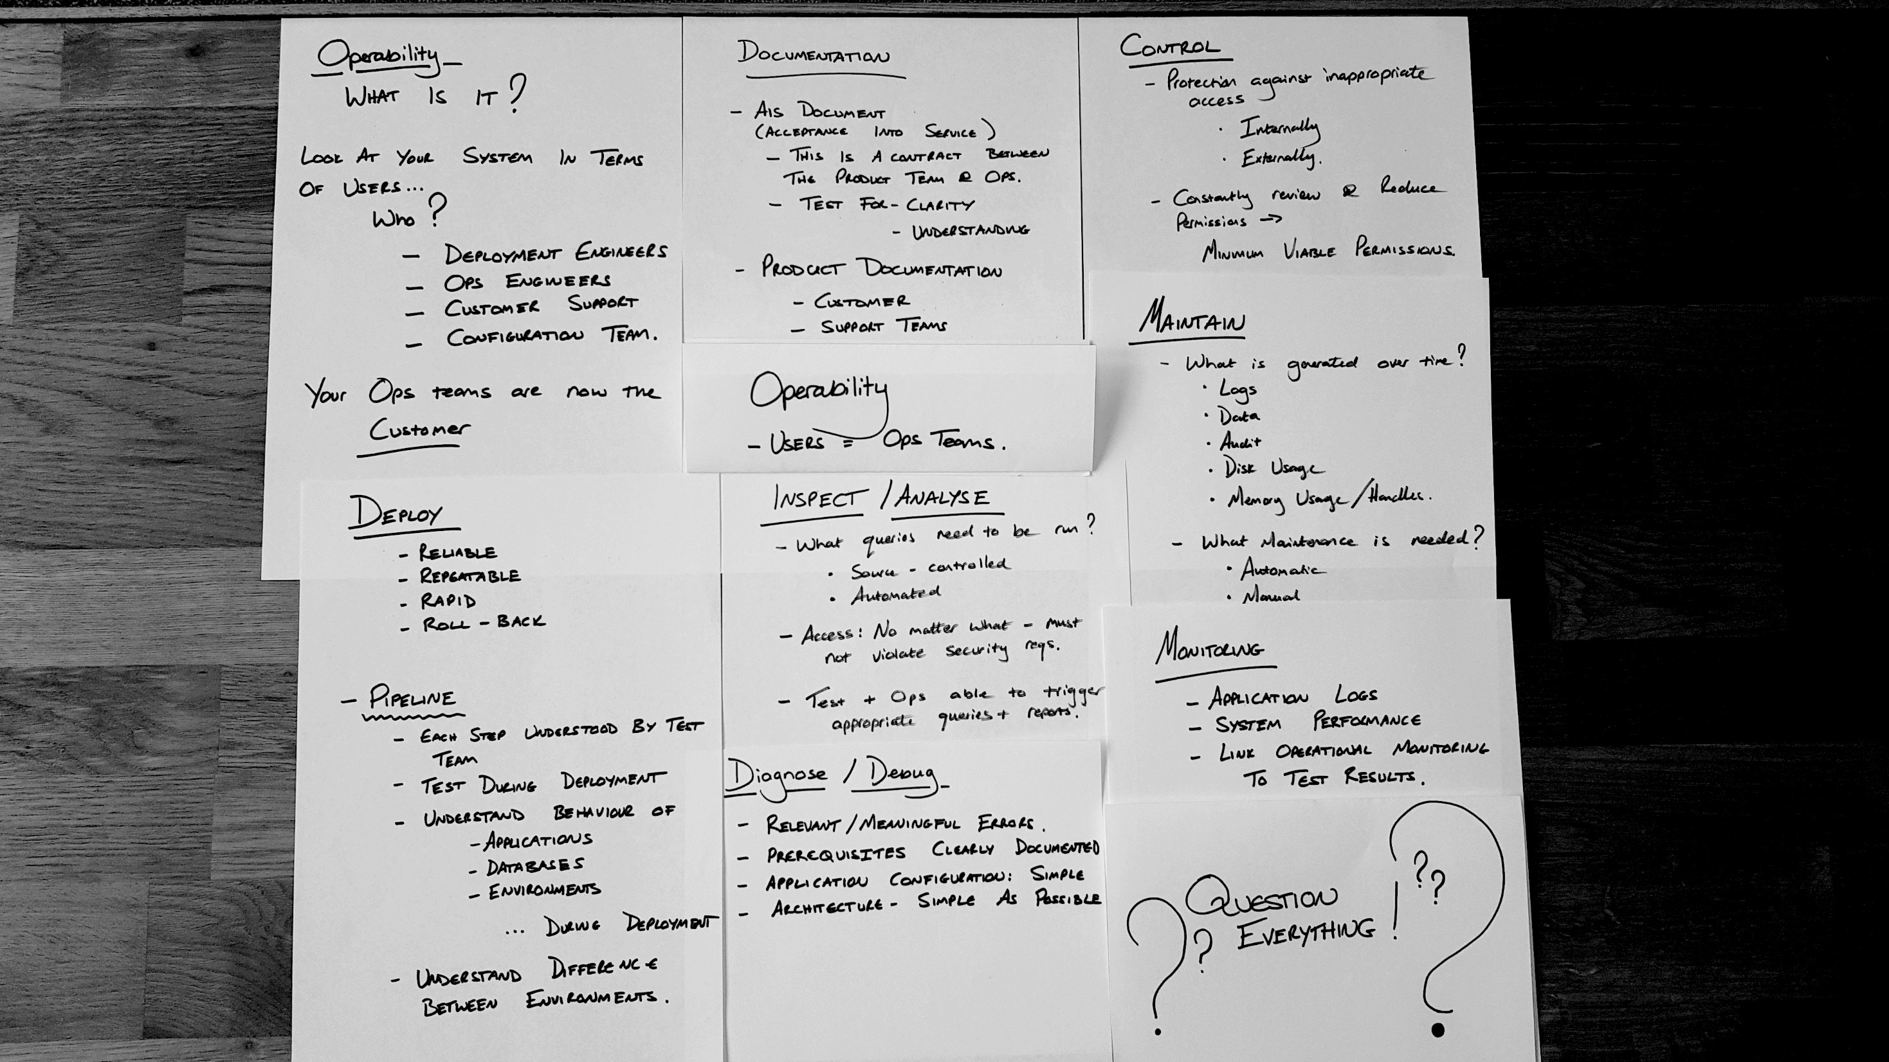
@smileandeliver
Notes:
Started to map out what Operability is, what it SHOULD BE from a ton of different sources including our own internal documentation.
Not only should we be thinking about all these matters – we need to know this stuff from the start and actually be able to test for them/prove them early, as close to walking skeleton stage as poss
CERTAIN CLEAR HEADINGS

Slide 22

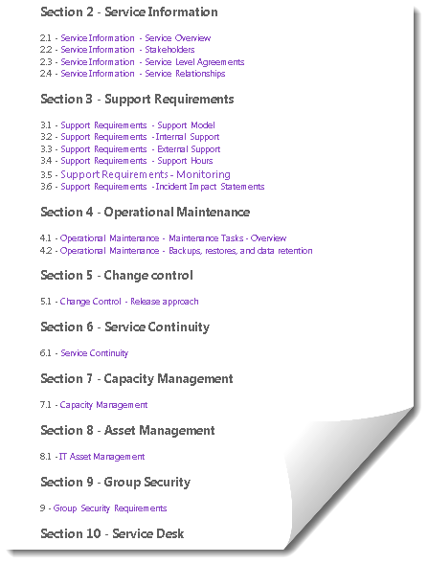
Operability Documentation
AIS DOCUMENT
(Acceptance into Service)
Operability Contract between All teams
Clarity
Understanding
Completeness
PRODUCT DOCUMENTATION
Customer Facing
Support
Architecture
Notes:
· Recovery Time Objective (RTO)
· Recovery Point Objective (RPO)
· Minimum Recovery Operating Level (MROL)
Not just terms in a document…

Slide 23


Deployability
Walking Skeleton
Reliable
Repeatable/Reproducible
Rapid
Roll-back
PIPELINES
Each step understood
Applications / Services
Databases
Environments
Test During Deployment
Notes:
One of the things your walking skeleton can prove for you right at the start is deployability
Reliable – works, proved
Repeatable – you can do exactly the same deployment again. Reproducible – you get exactly the same results when you repeat
Rapid – self explanatory. In our world we also include FREQUENT in there. Roll-back or Roll forward – what are you going to do when it inevitably fails
Simple, well understood steps – know all the applications, services, prerequisites. Deployment pipelines make sense – databases probably deployed separately
Obfuscated variables
Known variables
Minimum difference in deployment to each environment
Automatic communication steps

Slide 24

Maintainability
What builds up over time?
Logs
Data
Audit
Memory Usage
What Maintenance is Needed?
Automatic
Manual
@smileandeliver
Notes:
The main thing about this list is that all the logs and data should be shipped and stored to an appropriate location, be useful, necessary and AUTOMATIC
Of course Memory usage should not build up over time as well – it’s been a long time since I’ve seen an application misbehaving in this way but we could get complacent.

Slide 25
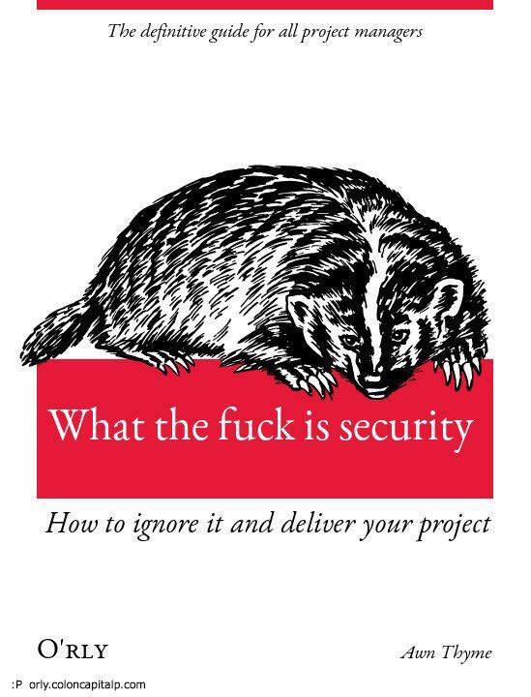
Control
Protection against inappropriate access
Internally
Externally
Regularly Review and Reduce Permissions
Minimum Viable Permissions
Access via Controlled System
Access Audit
What the F*** Is Security?
Notes:
Gatekeeping – we are overseen by ICO, PCI DSS, FCA and of course GDPR. So we have extra security and control considerations including for example that anyone who writes the code is not allowed to deploy the code to upper environments – so that’s PreProd, Prod, CT, Prod2/DR
Scanning of code and packages we use
Are the environments trustworthy/’sterile’/known
ICO : Responsible for regulating the use and storage of personal information, and for overseeing the implementation of the Freedom of Information (FOI) Act
PCI Security Standards Council : a global open body formed to develop, enhance, disseminate and assist with the understanding of security standards for payment account security. Originally founded by American Express, Discover Financial Services, JCB International, MasterCard, and Visa
FCA – replaced the FSA in 2013 following a review of the collapse of the financial markets some years earlier. Has wide ranging powers to regulate conduct related to the marketing of financial products. Aims to put the consumer’s needs at the centre of everything
Europe - GDPR

Slide 26

Monitoring
Application Logs
System Performance
Link Ops Monitoring to Test Results
Everyone has access to the same dashboards
Signal to Noise Ratio
@smileandeliver
Notes:
Are the logs in a form that can be shredded and output meaningfully within our ELK stack
Are we grabbing the right info from the environments – we have more agents now with the newest Elastic offering so the dev and teams need to understand these and make the most of them
Need to understand how to configure the beats agents - but.. Share best practice across the dev teams so that the ops teams aren’t looking at very different info for each product
Is the test data comparable to live data – how can it be brought closer so that we can see exactly what changes might come thro with the next version

Slide 27

Inspect/Analyse
What queries need to be run?
Source-Controlled
Automated
Access: Must comply with Security Reqs
Test & Ops Teams able to trigger Appropriate Queries & Reports
Diagnose/Debug
Relevant / Meaningful Errors
Prerequisites Clearly Documented
Simple:
Application Configuration
Architecture
@smileandeliver
Notes:
Can you see what settings are deployed
Is last known good config recorded and ready to be reapplied
Can you see and change settings (without redeploying) via API?

Slide 28
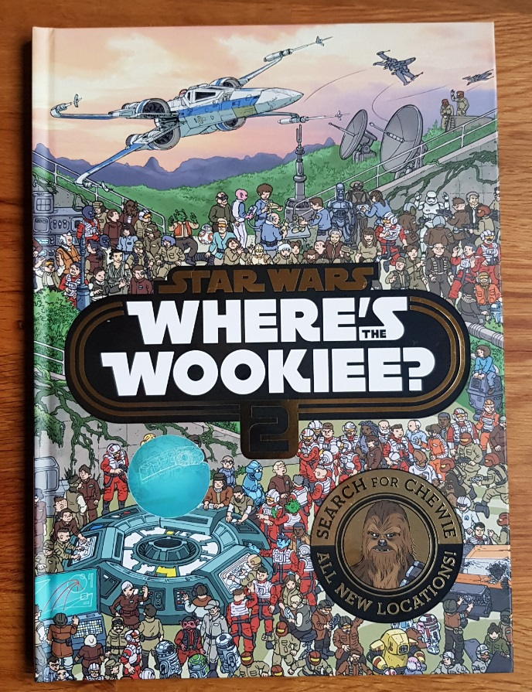
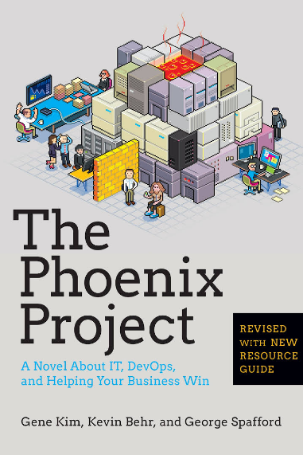
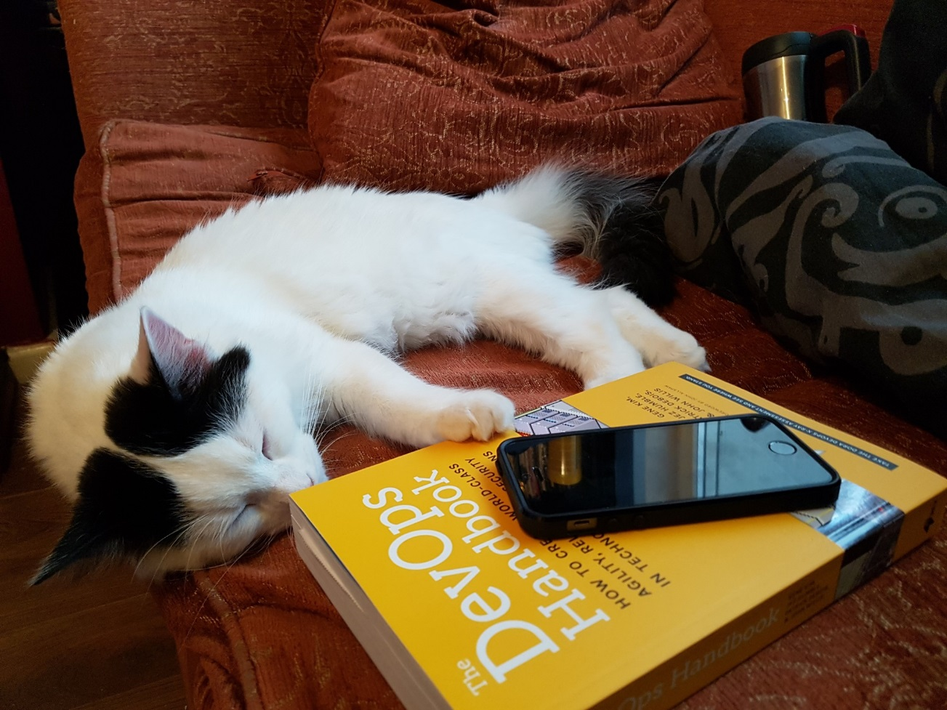
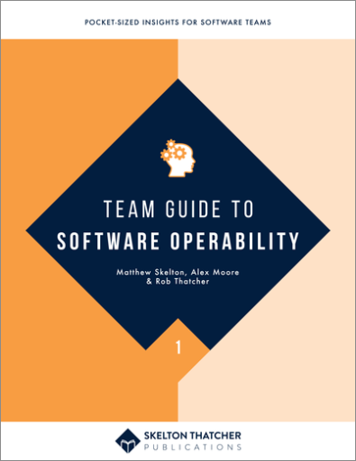
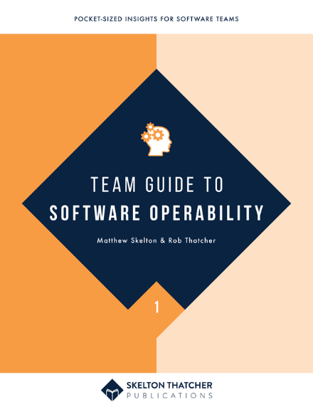
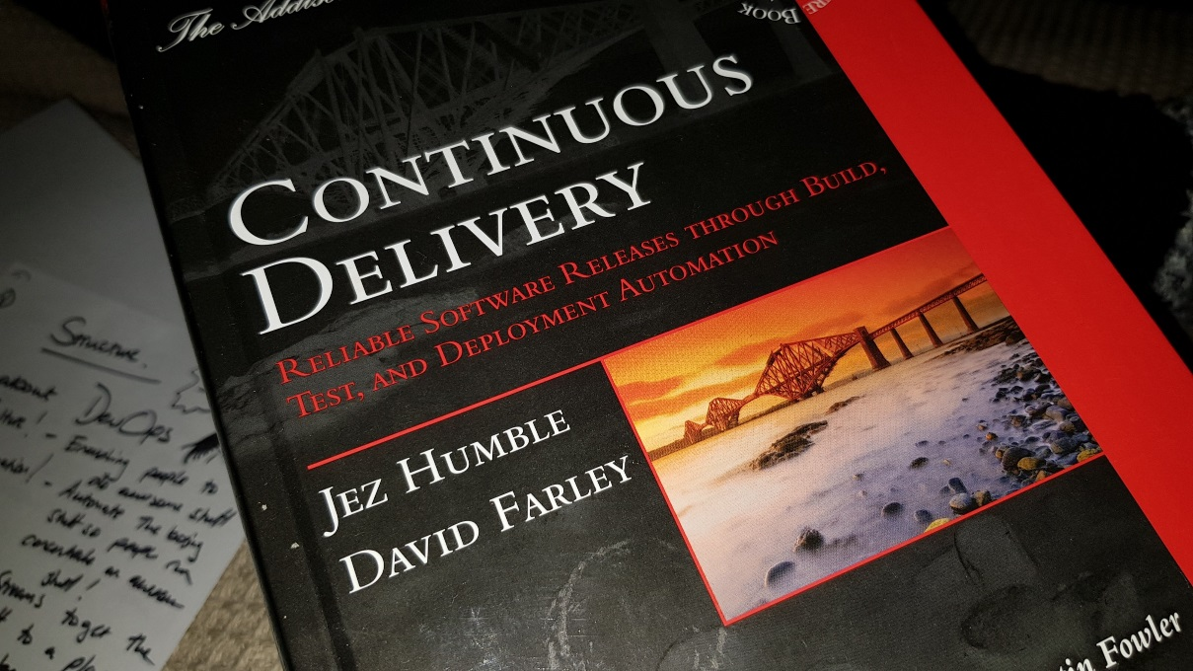
@smileandeliver
Notes:
Insert credits here particularly Continuous Delivery, DevOps Handbook, Phoenix Project and Software Operability Manuel Pais and Skelton Thatcher
I am just touching on the edges of this subject – there is so much more out there. Just saw this morning there’s a new publication from Skelton Thatcher about Software Releasability
There are so many excellent blogs and articles
https://medium.com/devopslinks/painless-software-quality-code-defensively-fail-early-test-continuously-69325923fbb6
https://pdfs.semanticscholar.org/4e57/2a1a4ff43b5666552cb70f4e4062f597bb05.pdf

Slide 29

Header
@smileandeliver
https://github.com/smileandeliver/
http://teamguidesforsoftware.com
https://leanpub.com/SoftwareOperability/c/DevTestNorth20

